Slide 1


CS Dungeon -Tutorial for developers-
By Team Bugatti
CS4900 Senior Seminar
Andrew Tucker, Jermy Craven, Kevin Patel, William Lee, Hoyong Lee, Dongwoon Jeong

Slide 2
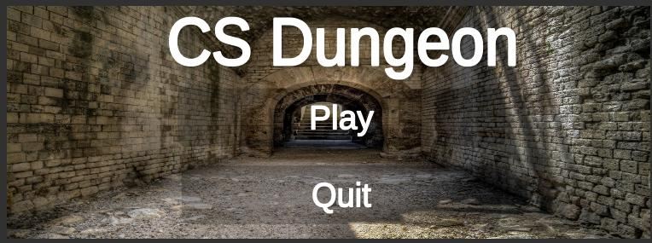




01
What is CS Dungeon
CS Dungeon is a 2D side-scrolling video game format game and was created by Team Bugatti using the Unity game engine and C# programing language.
Run & Gun
2D side-scrolling video game
Various Weapons
Background of the game
(CS Course)
Easy to play
Main screen of CS Dungeon

Slide 3

02
What is Unity
Unity is a game engine that provides a development environment for 3D and 2D video games, and an integrated authoring tool for interactive content creation such as 3D animation and architectural visualization, and virtual reality (VR). Windows, Mac OS, iOS, Android, Playstation, Xbox, Nintendo Switch, Web Browser (WebGL) can be used to create content available on 27 platforms, Unity Editor, a production tool, supports Windows and MacOS.
System Requirement
OS: Windows 7 SP1+, 8, 10, 64-bit versions only; macOS 10.12+ Server versions of Windows & OS X are not tested.
CPU: SSE2 instruction set support.
GPU: Graphics card with DX10 (shader model 4.0) capabilities.
The rest mostly depends on the complexity of your projects.

Slide 4
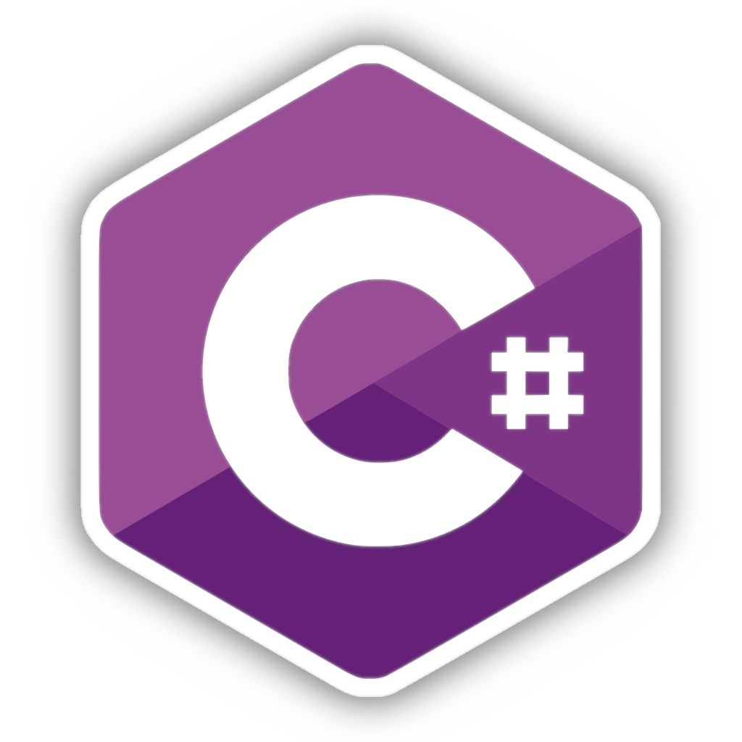
03
What is C#
C# is an object-oriented programming language developed by Microsoft that made it part of the dot-net framework and later became the standard for ECMA and ISO. It has a grammar like C++ and Java.

Slide 5
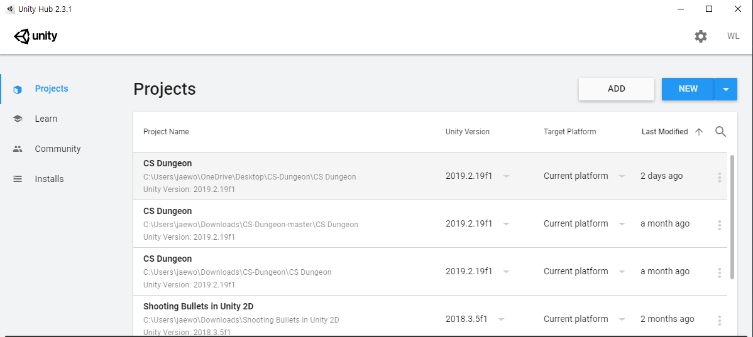
04
Basic Setting
If you open Unity Hub, project screen pops up.
Now let's make a project to go a long way.

Slide 6
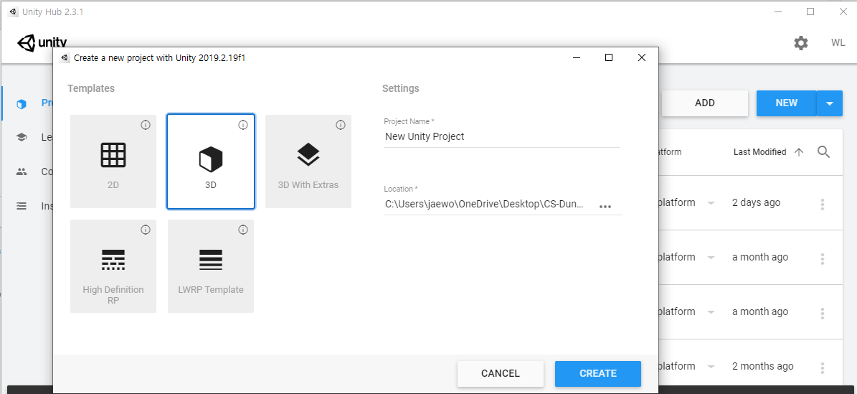
05
Basic Setting
Select the templates for your project.
Click create.

Slide 7
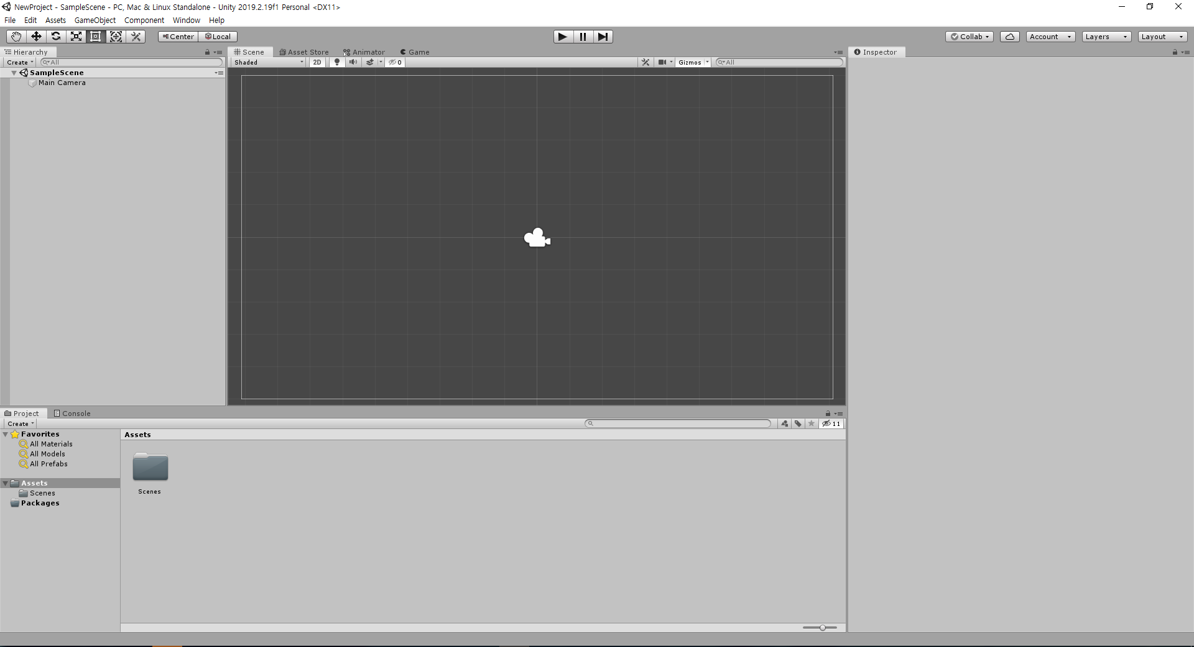
06
Basic Setting

Slide 8
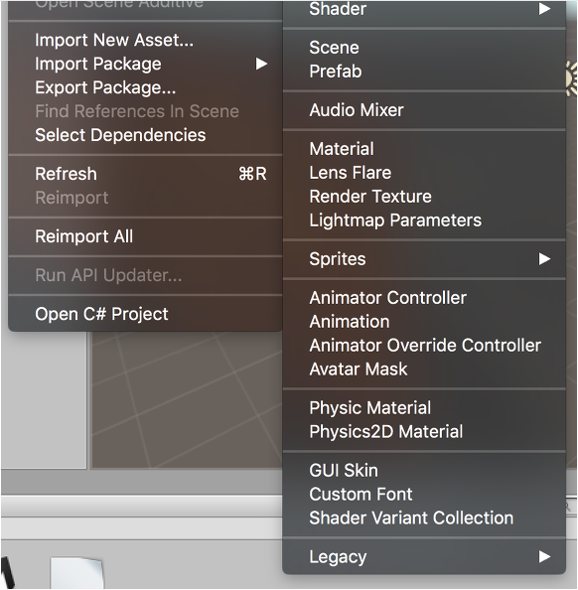
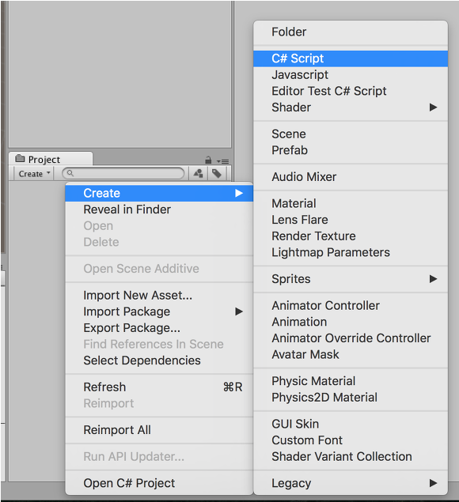
07
How to create script?
Method 1: Assets → Create → C# Script
Method 2: Right click the project tab →Create → C# Script

Slide 9
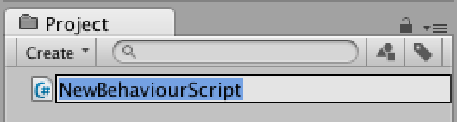
08
Basic Setting
If you create it in one of two ways, let's name like this. It's a good idea to designate once you create it. This is because Unity refers to the file name when naming C# classes.

Slide 10
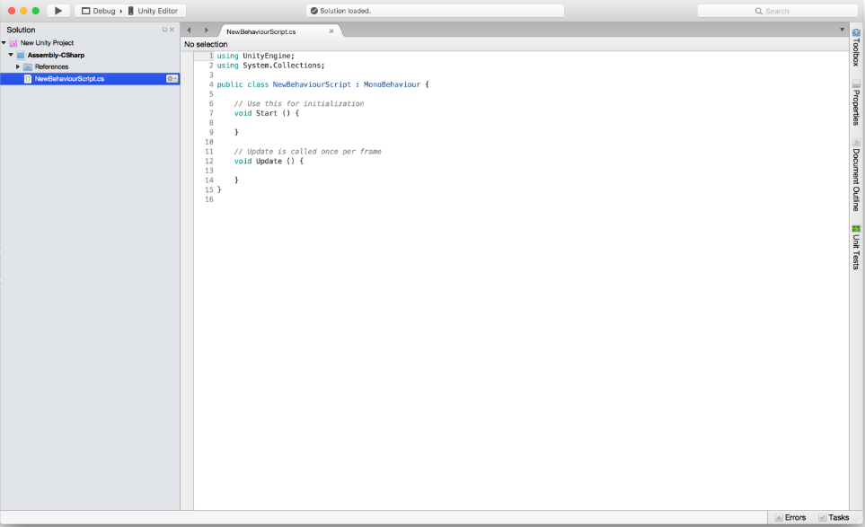
09
Basic Setting
If you double-click a script to see the basic structure of the script in Monodevelop, an editor provided by Unity by default.

Slide 11
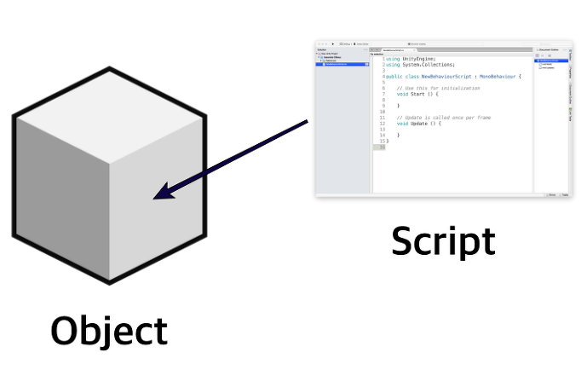
10
Instantiation of script
For example, there are human-shaped objects or car-shaped objects in the Unity program. It's just a lump right now, but you can put the script in a component to make people run, or you can do anything to get the car to turn left. This process is to 'create an instance of Script and put it in Object' and you can replicate the same functionality to multiple instances of Script. Ideally, the instance should be reused as useful as possible for multiple objects.

Slide 12
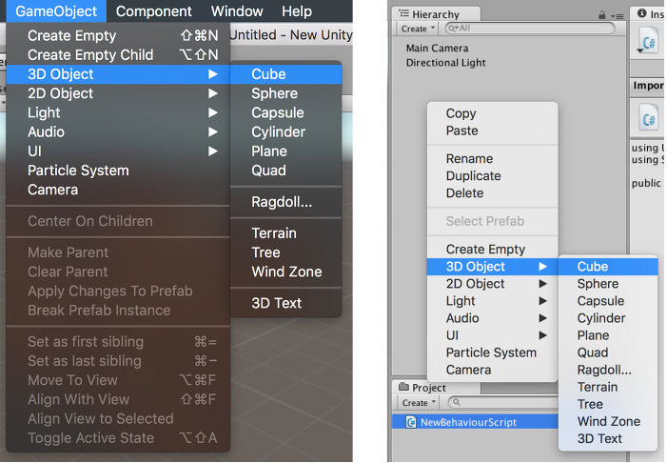
11
Apply script to the object
Now, let's instantiate the script. Creates the object for the instant script as shown above.

Slide 13
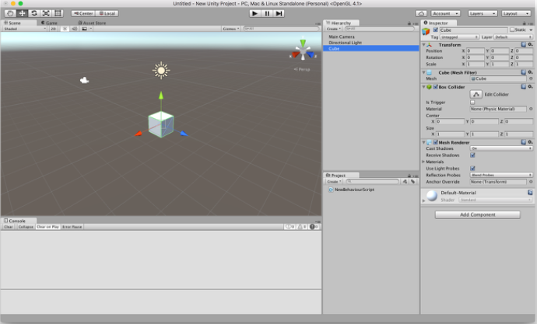
12
Apply script to the object
It is normal to create a white cube like above. Now let's put a script in this cube.

Slide 14
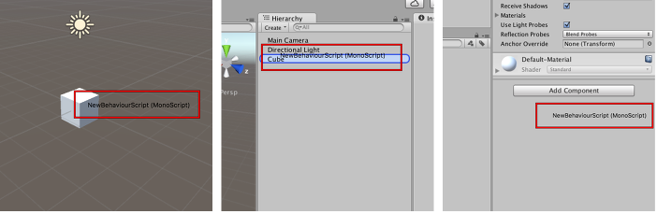
13
Apply script to the object
There are three ways to insert a script: drag and drop the script directly into the object, in the name of the object on the Hierarchy tab, at the bottom of the inspector that appears when you click the object.

Slide 15
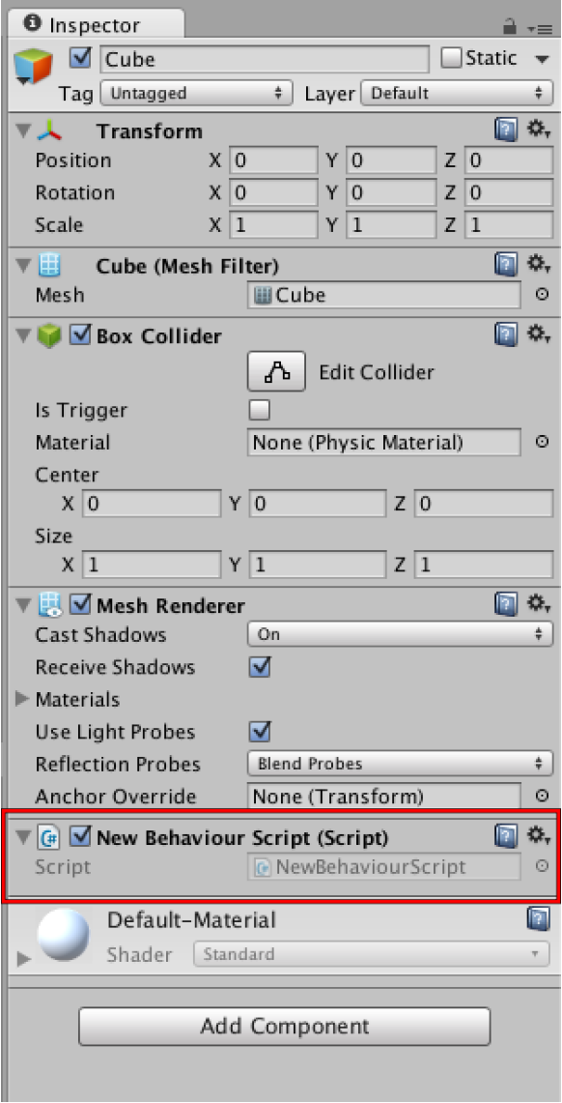
14
Apply script to the object
Once the instantiation is complete, it is visible on the Object Inspector tab, and the public variables in the script are visible.

Slide 16
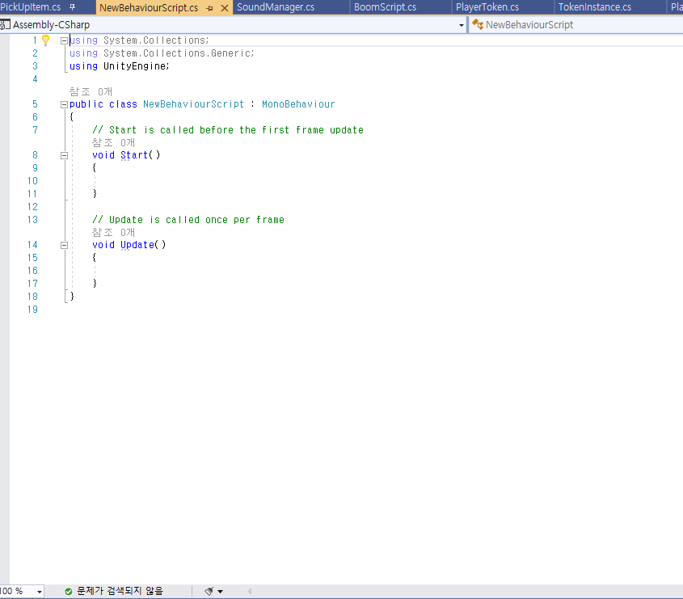
15
Structure of script
Name Space: Location of key commands available in scripts
Class and Class Declarations Unity C# scripts are one class
Default Class Inheritance
Used to initialize script variables as a function that runs automatically at the start of the game
A function that runs over and over every frame, for example, 60 frames per second of a game, drawing 60 screens per second.

